Slide 1
WEB ANALYTICS GROUP PROJECT (INTERNATIONAL AVIATION NETWORK)
GROUP MEMBERS:
Sharmilly Thurai Raja G1901884G
Shingar Aggarwal G1901889C
Tham Chay Yong Gerald G1902212G
Teo Shin Siong Japheth G1800706E
Lee Wei Yang Shawn G1801333C

Slide 2

Agenda
01
INTRODUCTION
02
DATA
DATA SOURCE
DATA PREPROCESSING
03
EXPLORATORY DATA ANALYSIS
04
PAGERANK
05
PROBLEM STATEMENTS
WHAT ARE THE TOP THREE MOST POPULAR AIRPORTS?
WHICH NODES FORM A COMMUNITY?
WHICH ARE THE TOP TEN AIRPORTS THAT HAVE THE HIGHEST BETWEENNESS SCORE AND WHY?
06
CONCLUSION
07
PROJECT ACHIEVEMENTS
08
RECOMMENDATION

Slide 3
INTRODUCTION

Slide 4

INTRODUCTION
The objective is to identify communities and key players in the international aviation network.
Several popular algorithms were applied, and a comparison between the various algorithms’ accuracy and applicability in aviation networks was done.
Analysed the global structure of the worldwide air transportation network, a critical infrastructure with an enormous impact on local, national, and international economies
Attempted to derive insights from the network characteristics, such as degree distribution, clustering coefficient distribution, node betweenness, closeness centrality, authority and hub nodes

Slide 5
DATA

Slide 6

DATA SOURCE
https://openflights.org/data.html
Passenger flights data only.
Covers over 60,000 routes and 3000 airports
Airport and airlines data updated as of January 2017.
Routes data updated as of June 2014.

Slide 7
DATA PREPROCESSING
We selected certain columns from airport.csv and routes.csv.
We selected the source countries, destination countries, latitudes and longitudes of the source and destination countries for our project.
From the 6 columns, there were null values in the source or destination countries, represented by “\N” in the excel file.
We dealt with the null values by removing them from the data set.
The betweenness score of the network was computed at this point
We have tuples where the source and destination countries were the same.
This is presumed to be internal domestic flights and we removed these tuples as well in order to increase model performance and efficiency.
As a result, we have about 33058 routes in the remaining tuples
The data source has three csv files: airport.csv, airline.csv, routes.csv.
Airline.csv is only used for the EDA part of the project.

Slide 8
EXPLORATORY DATA ANALYSIS

Slide 9
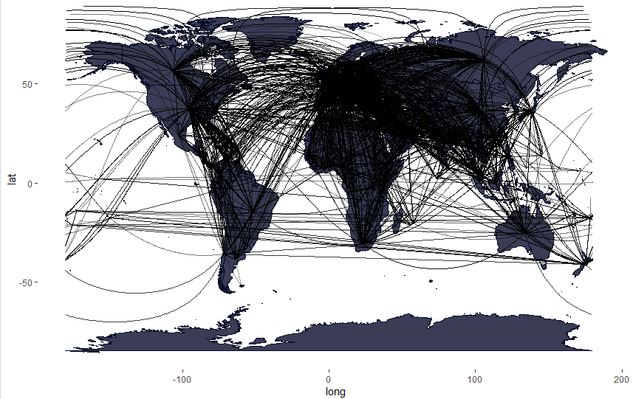
AIRLINE ROUTES

Slide 10
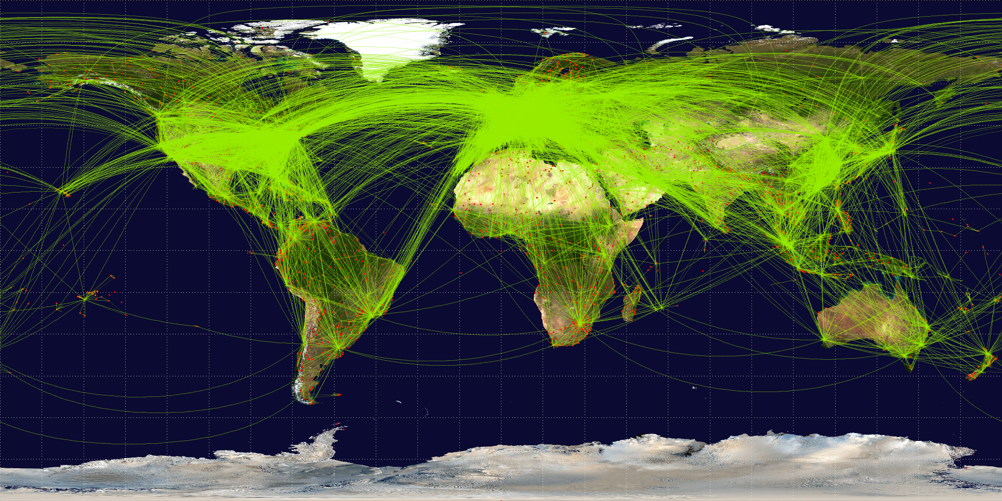
NETWORK SUMMARY CHARACTERISTICS
Using the igraph package in R:
Number of nodes (airports): 3330
Number of edges (routes): 67240
Average total degree: 40.38
Average in-degree: 20.19
Mean path length: 4.07
Network Diameter: 13
Global Clustering Coefficient: 0.25
Notes:
Mean path length: of shortest path over all pair wise vertices u and v
Network diameter: Max path length of shortest path over all pair wise vertices u and v
Global Clustering Coefficient: Transitivity measures the probability that the adjacent vertices of a vertex are connected. This is sometimes also called the clustering coefficient.

Slide 11
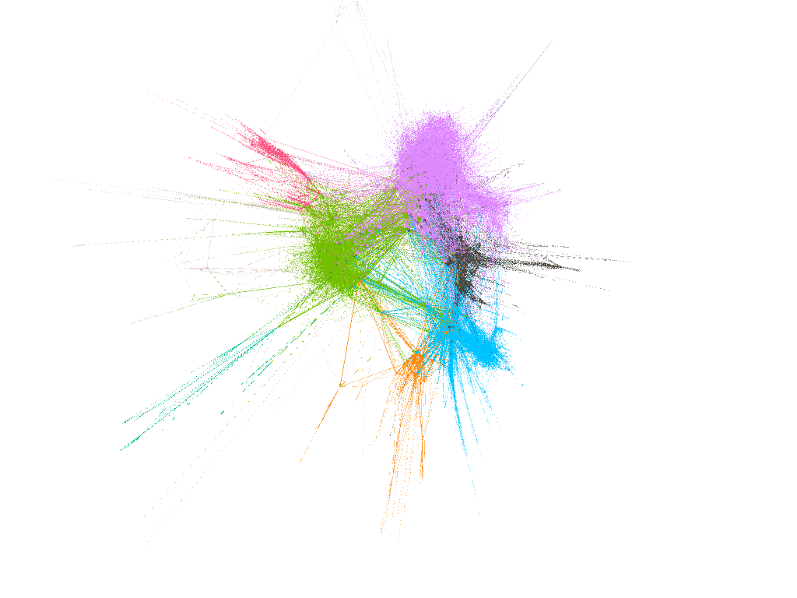
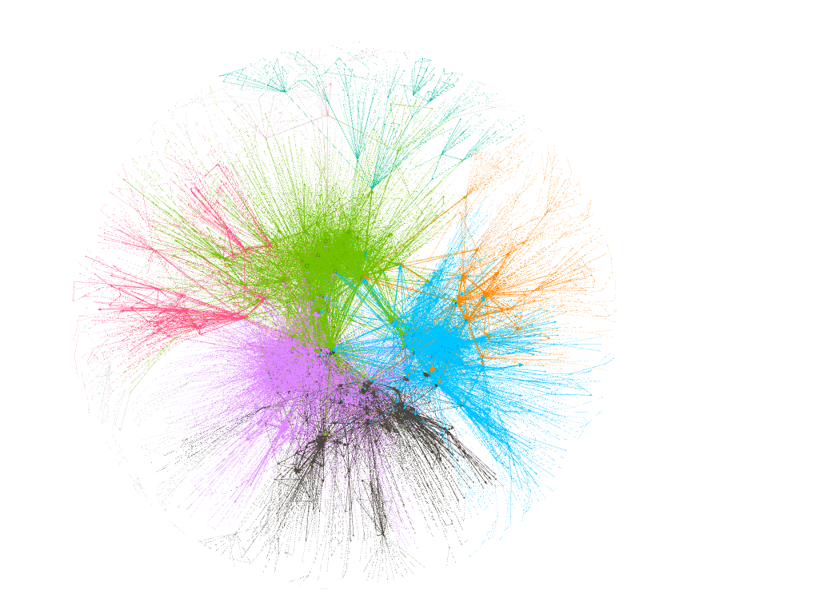
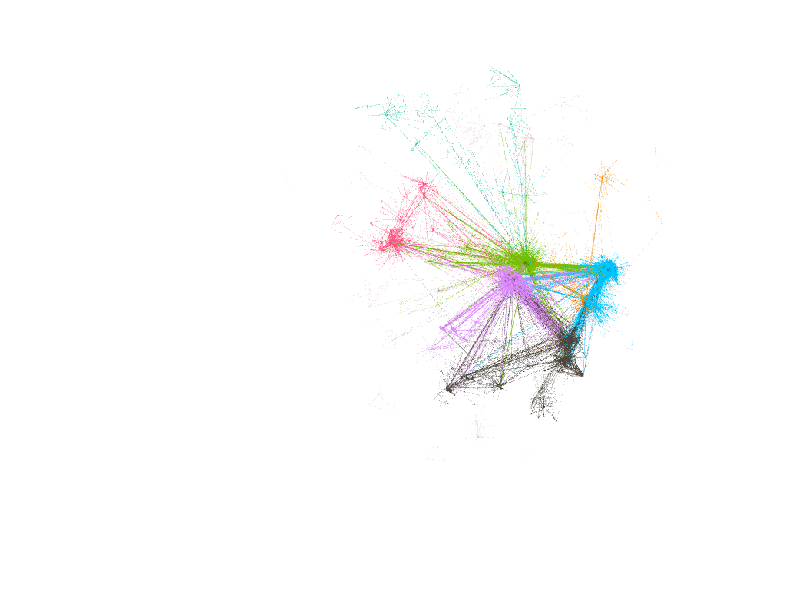
NETWORK GRAPH
OPENORD
FRUCHTERMAN REINGOLD
FORCE ATLAS

Slide 12
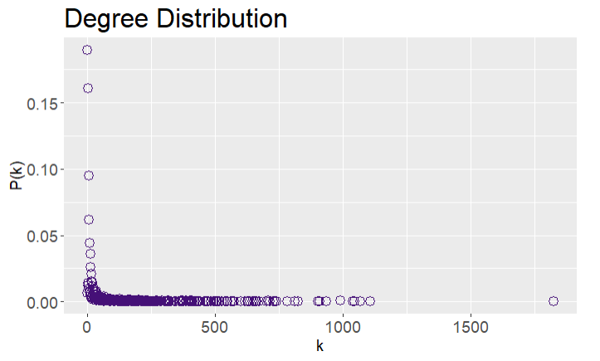
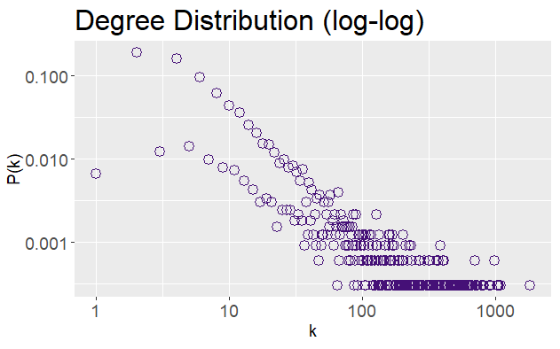
DEGREE DISTRIBUTION
Closely approximates a power law, P(k)~k^-r
Aviation network is a Scale-free network, where some airports act as highly connected hubs, but most airports are of low degree
Notes:
Degree Distribution: Gives the probability that a selected node has exactly “k” links
This also suggests that the phenomenon of preferential attachment is at play where nodes tend to connect preferentially to nodes with already high degrees. In addition, the spreading of P(k) values at high k represents noise in the tail, due to very low number of observations at high k.

Slide 13
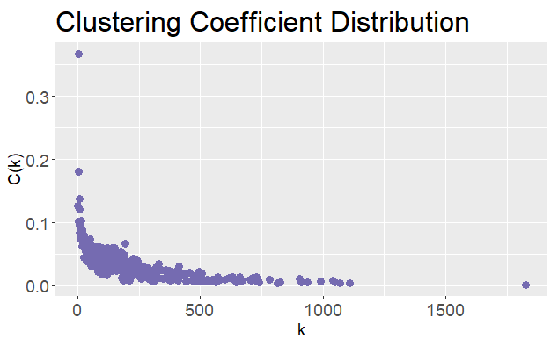
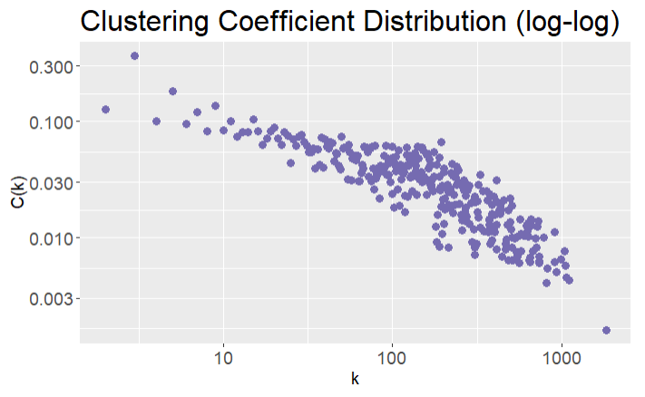
CLUSTERING COEFFICIENT DISTRIBUTION
Plot below strongly resembles a hierarchical network.
In such networks, it is assumed that clusters combine in an iterative manner to account for the coexistence of modularity, local clustering, and scale free topology.
Notes:
The clustering coefficient characterizes the node’s tendency to form clusters or groups.

Slide 14
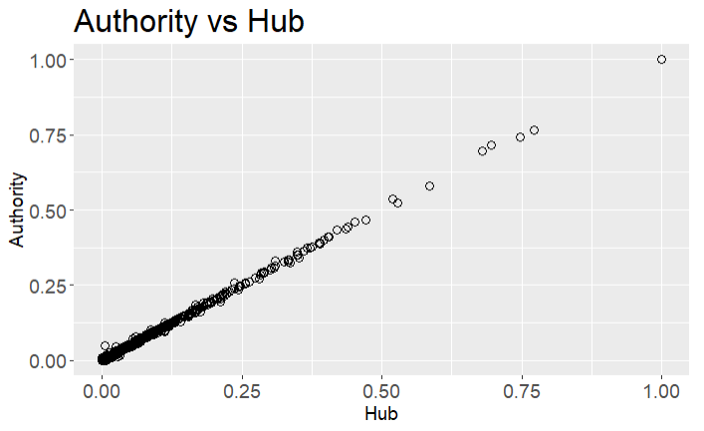
AUTHORITY AND HUB SCORES OF EACH AIRPORT
Notes:
The authority and hub scores were obtained using the authority_score() and hub_score() functions in the igraph package, and the plot below shows that there is a very strong positive correlation between authority and hub scores. This means that each flight route roughly has the same number of incoming and outgoing flight for each pair of source and destination airports. This is logical as most of the passengers travel both ways unless there is a large scale permanent emigration. Furthermore capacity constraints in airports mean that there cannot be many more incoming flights than outgoing, or else it will form a major bottleneck for airport operations.
Therefore the authority and hub scores are not very useful as metrics for key player identification in the aviation network. It should be more applicable in the bibliographic network or social network analysis context.

Slide 15
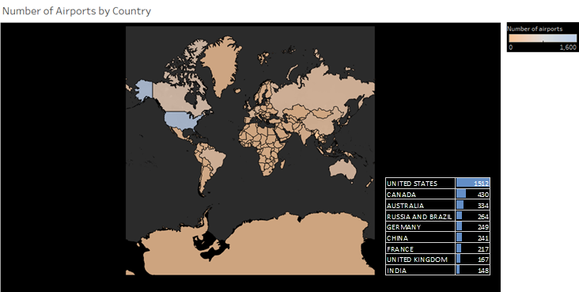
AIRPORTS BY COUNTRY
This Figure shows the map based on the longitude and latitude.
Colour shows sum of numbers of airports and the details are shown for the countries with the ten highest number of airports.
From this figure it can be concluded that the USA has the highest number of airports.

Slide 16
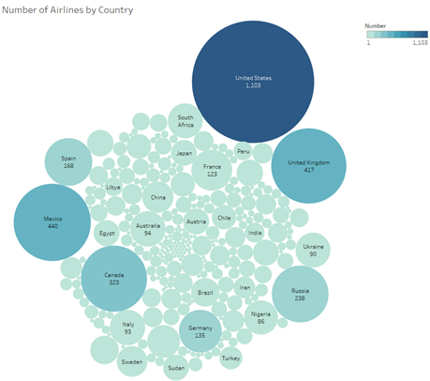
AIRLINES BY COUNTRY
Displays the number of airlines by country.
Colour and different sizes depict the sum of numbers of airlines.
The marks are labelled by country and the sum of numbers.
Apart from having the highest number of airports, USA also has the highest number of airlines.

Slide 17
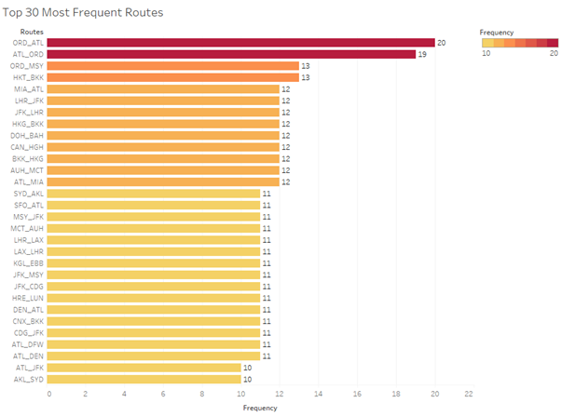
TOP 30 MOST FREQUENT ROUTES
This figure is created to visualize the frequency of the top thirty routes
Each bar chart is labelled by frequency of the specified route.
The route from ORD to ATL has been travelled most by the airlines

Slide 18
PAGERANK

Slide 19
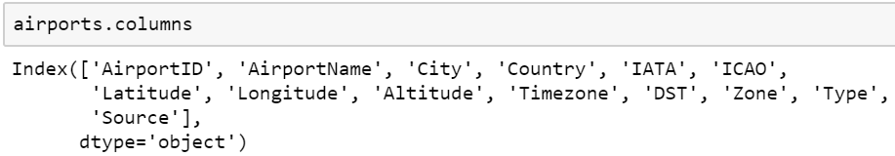

DATASET
Airports
Routes
IATA airport code, is a three-letter geocode designating many airports and metropolitan areas around the world
.
OrgIATA is the code for the airport of origin from which the flight takes off and DstIATA is the code for the destination airport at which the flight lands

Slide 20
DATA PREPROCESSING
Replacing Null Values
All null values represented by “\N” were replaced with NaN values. This was to allow us to have a visibility of the number of null values under each column for both data files
Duplicate Data
For data cleaning, the airports data was checked for duplicate IATA codes. For source and destination airports that are the same, we removed them as well.
Redundant Values
Omit Null Values
For the routes data, OrgIATA and DstIATA codes found in the in the airports data is kept and the rest are omitted
IATA codes with null values were omitted for airports data

Slide 21
DATA PROCESSING
Graph Formation
All the airports are the nodes while the routes represent the edges
Dead-end nodes & Non-Incoming Nodes
Dead-end nodes, nodes which do not have any outgoing routes and non-incoming routes belong to airports which do not have incoming routes.
These were identified and integrated in to each iteration of the algorithm
Performance
Result
The convergence and computational time of the algorithm is affected by the number of nodes, damping factor etc. The number of nodes affect the speed of computation but not the number of iterations. The damping factor, l is said to be proportional to the speed of convergence. We decided to use l=0.85 as in literature it is the most commonly used damping value
The final result consists of the destination airports that have incoming routes

Slide 22









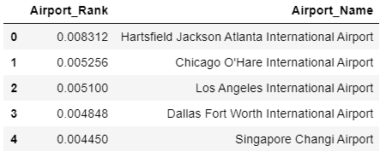
RESULT

Slide 23
PROBLEM STATEMENTS

Slide 24
PROBLEMS STATEMENTS
03
02
WHAT ARE THE TOP 10 AIRPORTS THAT HAVE THE HIGHEST BETWEENNESS SCORES? WHY SO?
01
WHICH NODES FORM A COMMUNITY?
WHAT ARE THE TOP 3 POPULAR AIRPORTS?

Slide 25
WHAT ARE THE TOP 3 POPULAR AIRPORTS?
We used the network measure: degree to find out the top 3 most popular airports. We assumed popular to be the nodes with the highest degree. From the findings, we have
O’Hare Airport, Chicago, USA
Heathrow Airport, London, UK
Paris-Charles De Gaulle, France
Insights: It is peculiar that O’Hare airport has the highest degree. We found out that O’Hare airport is also an airport that serves the US military aircrafts. This might explain why the degree is highest.

Slide 26
2. WHICH NODES FORM A COMMUNITY?
We used 2 community detection algorithm: Walktrap community and Leading Eigenvector community algorithm
Walktrap community: 13 communities returned, with 5 major communities identified.
America (comprising of members such as Columbia, United States, Argentina, Mexico, Brazil etc)
Africa (comprising as members such as Somalia, South Africa, Ethiopia, Rwanda etc)
Europe (comprising of members such as Italy, France, United Kingdom etc)
Asia (comprising of members such as China, Hong Kong, Singapore, Japan etc)
Middle East (Egypt, Afghanistan, India, Pakistan etc)
Leading Eigenvector community: 5 communities detected.
Problem with this model: groups countries that are much further apart together as well. (eg it grouped South Korea with Madagascar, New Zealand and Bhutan together.) These countries are rather far apart. This suggested to us that this algorithm is less than optimal.

Slide 27
COMPARISON BETWEEN THE 2 COMMUNITIES DETECTED
We used the modularity score to compare the 2 communities. Modularity reflects the concentration of edges within modules compared with random distribution of links between all nodes regardless of modules.
For the walktrap community, the modularity score is 0.4366818 while the score for the leading eigenvector community is 0.4342501. This is in line with our conclusion in the previous slide, although the difference is not large.

Slide 28
3. WHAT ARE THE TOP 10 AIRPORTS THAT HAVE THE HIGHEST BETWEENNESS SCORES? WHY SO?
Betweenness centrality in this project defines and measures the importance of an airport in the aviation network based on how many times it occurs in the shortest path between all pairs of airports in the network
The betweenness() function from the igraph package was used.

Slide 29
BETWEENNESS SCORES
Rank | IATA Code | Airport | City, Country | Betweenness Score
1 | LAX | Los Angeles International Airport | Los Angeles, USA | 837,419.9
2 | FRA | Frankfurt Airport | Frankfurt, Germany | 819,061.1
3 | ANC | Ted Stevens Anchorage International Airport | Anchorage, USA | 779,059.3
4 | CDG | Charles de Gaulle Airport | Paris, France | 691,502.8
5 | LHR | London Heathrow Airport | London, UK | 610,857.4
6 | ORD | O’Hare International Airport | Chicago, USA | 610,586.4
7 | DXB | Dubai International Airport | Dubai, UAE | 587,573
8 | SIN | Singapore Changi Airport | Singapore, Singapore | 574,032
9 | PEK | Beijing Capital International Airport | Beijing, China | 554,409.8
10 | GRU | São Paulo/Guarulhos–Governador André Franco Montoro International Airport | Sao Paulo, Brazil | 510,378.7
Top 10 airports with the highest betweenness scores
These airports serve as very important hub and authority nodes in the aviation network

Slide 30
BETWEENNESS SCORES
While ORD, LHR and CDG has the most number of aviation connections, they are not the top three when it comes to exclusivity of air routes (although they did not fare too badly in terms of betweenness and were ranked 6, 5 and 4 respectively)
LAX, FRA and ANC have a high proportion of overall destinations in aviation travel that have to pass through these airports one way or another
USA took up 3 spots in the top ten betweenness score whereas the other countries only appeared once
Rank | IATA Code | Airport | City, Country | Betweenness Score
1 | LAX | Los Angeles International Airport | Los Angeles, USA | 837,419.9
2 | FRA | Frankfurt Airport | Frankfurt, Germany | 819,061.1
3 | ANC | Ted Stevens Anchorage International Airport | Anchorage, USA | 779,059.3
4 | CDG | Charles de Gaulle Airport | Paris, France | 691,502.8
5 | LHR | London Heathrow Airport | London, UK | 610,857.4
6 | ORD | O’Hare International Airport | Chicago, USA | 610,586.4
7 | DXB | Dubai International Airport | Dubai, UAE | 587,573
8 | SIN | Singapore Changi Airport | Singapore, Singapore | 574,032
9 | PEK | Beijing Capital International Airport | Beijing, China | 554,409.8
10 | GRU | São Paulo/Guarulhos–Governador André Franco Montoro International Airport | Sao Paulo, Brazil | 510,378.7

Slide 31

BETWEENNESS SCORES
Rank | IATA Code | Airport | City, Country | Betweenness Score
1 | LAX | Los Angeles International Airport | Los Angeles, USA | 837,419.9
2 | FRA | Frankfurt Airport | Frankfurt, Germany | 819,061.1
3 | ANC | Ted Stevens Anchorage International Airport | Anchorage, USA | 779,059.3
4 | CDG | Charles de Gaulle Airport | Paris, France | 691,502.8
5 | LHR | London Heathrow Airport | London, UK | 610,857.4
6 | ORD | O’Hare International Airport | Chicago, USA | 610,586.4
7 | DXB | Dubai International Airport | Dubai, UAE | 587,573
8 | SIN | Singapore Changi Airport | Singapore, Singapore | 574,032
9 | PEK | Beijing Capital International Airport | Beijing, China | 554,409.8
10 | GRU | São Paulo/Guarulhos–Governador André Franco Montoro International Airport | Sao Paulo, Brazil | 510,378.7
Country | Number of Airports
United States | 1,512
Brazil | 264
Germany | 249
China | 241
France | 217
United Kingdom | 167
United Arab Emirates | 17
Singapore | 6

Slide 32

USA
Can be said to be the leading key player in the aviation network!!

Slide 33


ADDITIONAL ANALYSES
To take a closer look at these results, two additional analyses were made to see if betweenness scores had a correlation with the following external data..
Airport
Passenger Numbers (2018)
Airport
Cargo
in Tonnes
(2018)
Do airports with higher betweenness scores serve a higher number of passengers?
Do airports with higher betweenness scores transport more cargo?
LET’S FIND OUT…

Slide 34
ASSUMPTIONS
Proportion of passenger movement and cargo load versus the aviation network remain largely the same over the last few years (Aviation network consisted of data as of June 2014, the airport passenger and cargo load data used is in 2018)
Only the top 10 airports with the highest betweenness scores were made in these analyses
Airport
Passenger Numbers (2018)
Airport
Cargo
in Tonnes
(2018)
Do airports with higher betweenness scores serve a higher number of passengers?
Do airports with higher betweenness scores transport more cargo?

Slide 35
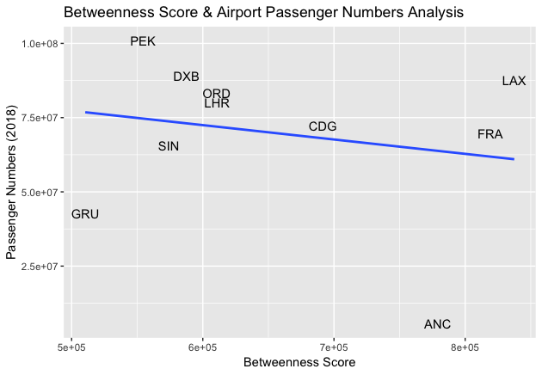
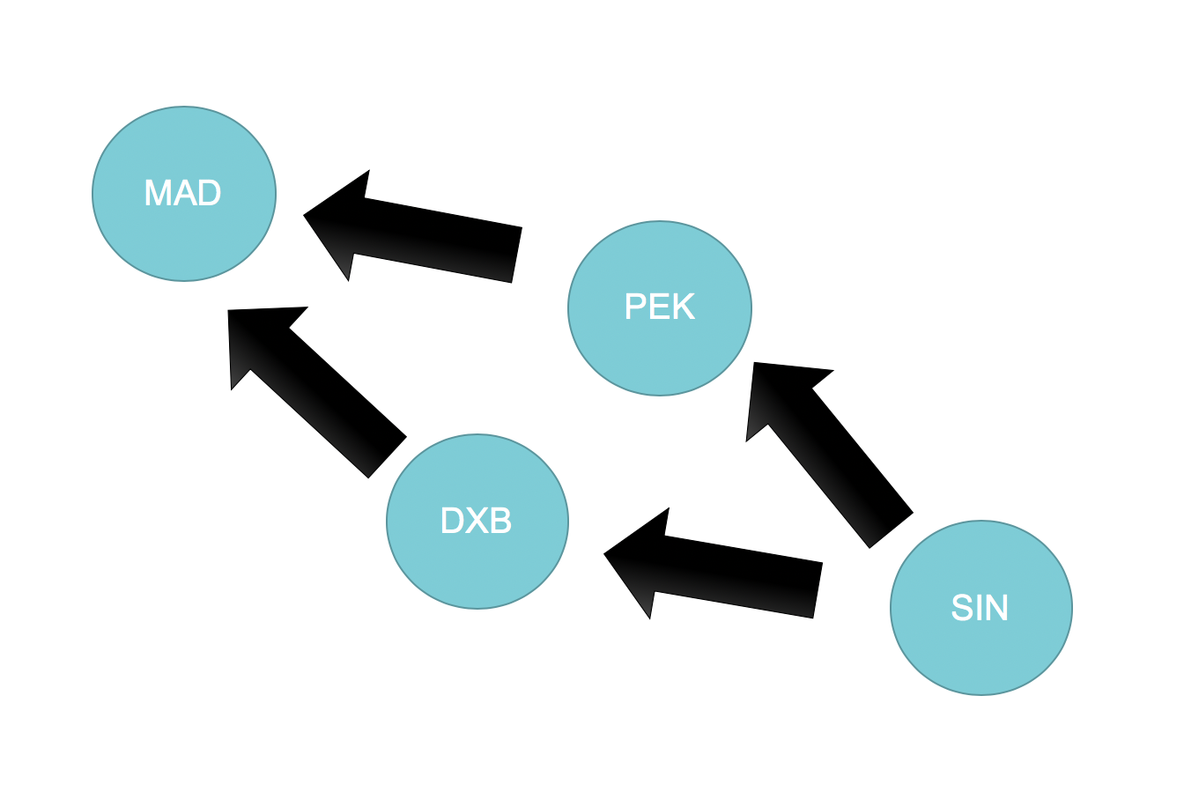
AIRPORT PASSENGER NUMBERS (2018)
As betweenness scores increased, passenger movements tended to decrease
Airports with higher betweenness scores did not mean higher passenger numbers
One hypothesis to explain this result can be that airports with very high passenger numbers and lower betweenness scores, such as Beijing and Dubai, tend to transit air passengers in large volumes to their final destination and this final destination has many alternate airport hub for the passenger to choose. These airports can be thought of as hubs with greater weights to nodes, which will also be reached by other hubs

Slide 36
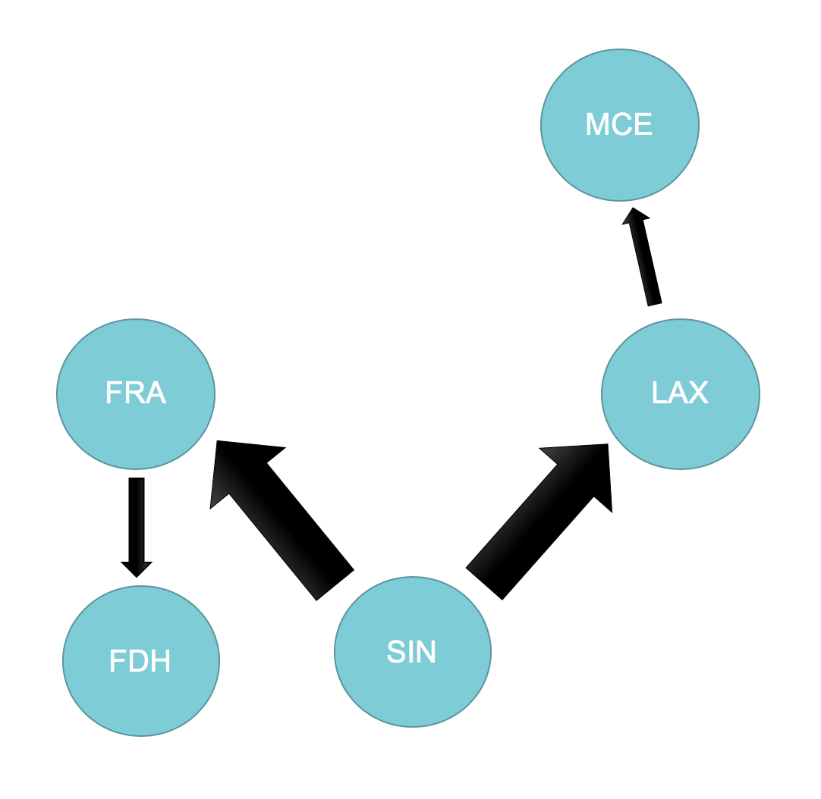
AIRPORT PASSENGER NUMBERS (2018)
Merced
Friedrichshafen
As betweenness scores increased, passenger movements tended to decrease
Airports with higher betweenness scores did not mean higher passenger numbers.
One hypothesis to explain this result can be that airports with very high passenger numbers and lower betweenness scores, such as Beijing and Dubai, tend to transit air passengers in large volumes to their final destination and this final destination has many alternate airport hub for the passenger to choose. These airports can be thought of as hubs with greater weights to nodes, which will also be reached by other hubs.
On the other hand, airports like Los Angeles and Frankfurt, transport relatively fewer passengers on each trip but covers a greater variety of destinations that are exclusive. They can be thought of as hubs with smaller weights to nodes not commonly served by other hubs.

Slide 37
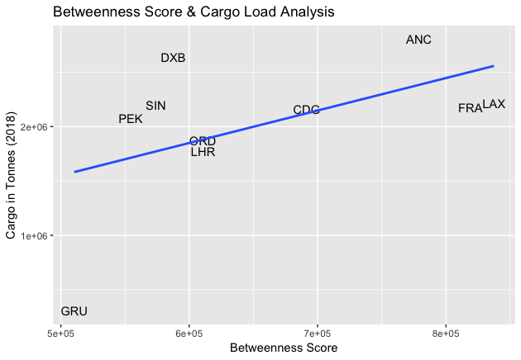
CARGO LOAD (2018)
As betweenness scores increased, cargo load also increased
Airports with higher betweenness scores meant more aircraft cargo were being transported
It can be suggested that the movement of cargo is behaviorally different from the movement of passengers
Movement of cargo may be more point to point, taking place at multiple places until they get to their destination
Passengers on the other hand have human needs and may opt to transit at fewer stops and their choice of an airport hub may be one with facilities and amenities for a more enjoyable aviation journey

Slide 38
CONCLUSION

Slide 39
Our analysis of the community structure of the aviation network is important for two reasons
Identify the communities, focus new routes on the poorly connected ones, helps resource allocation planning
Identify cities that connect different communities, helps in controlling dynamic processes (e.g. propagation of infections like the Wuhan corona-virus)
CONCLUSION
The betweenness score gave a good overview of important key players (in terms of countries) and key nodes in the aviation network
A cross-reference with passenger and cargo volume data provided
Airport specific insights
Behavioral differences between passenger and cargo travel
Notes:
1) Specifically, having identified the communities, one can identify which ones are poorly connected and the ways to minimize that problem

Slide 40
PROJECT ACHIEVEMENTS

Slide 41
PROJECT ACHIEVEMENTS
Analysed aviation network using
Network measures
(Degree Distribution, Scale-free
Network, Clustering Coefficient, etc)
Community detection algorithms
(Walktrap, Leading Eigenvector)
Link Analysis concepts
(PageRank, Betweenness Centrality)
Performed a deeper study from results of the betweenness score to further understand the underlying reasons by linking with external datasets.
Notes:
(degree measure, degree distribution, scale-free networks, mean path length, network diameter, clustering coefficient),
(walktrap community, eigenvector community)

Slide 42
RECOMMENDATION &
FUTURE WORK

Slide 43
RECOMMENDATION & FUTURE WORK
Using passenger movement and cargo load from the same timeframe for the betweenness score results study.
Perform network analysis at a broader level: city level or country level

Slide 44
REFERENCES
business.uzh.ch/dam/jcr:7ebaf68b-69a4-4f6e-9cdc-1d73c3fe0abc/srep30750.pdf
https://stackoverflow.com/questions/9471906/what-are-the-differences-between-community-detection-algorithms-in-igraph/9478989#9478989
https://www.ncbi.nlm.nih.gov/pmc/articles/PMC1142352/
https://www.sciencedirect.com/science/article/pii/S209252121730041X
https://towardsdatascience.com/graph-analytics-introduction-and-concepts-of-centrality-8f5543b55de3
https://www.flightsfrom.com/ANC
https://airwaysmag.com/best-of-airways/ted-stevens-anchorage-international-airport/

Slide 45
Thank you!

